Slide 1
Supporting pupils using differentiated instruction
Aims:
To discuss the teaching responsibilities in ensuring lessons meet the needs of all learners
To raise awareness of a range strategies to differentiate the curriculum

Slide 2


Slide 3
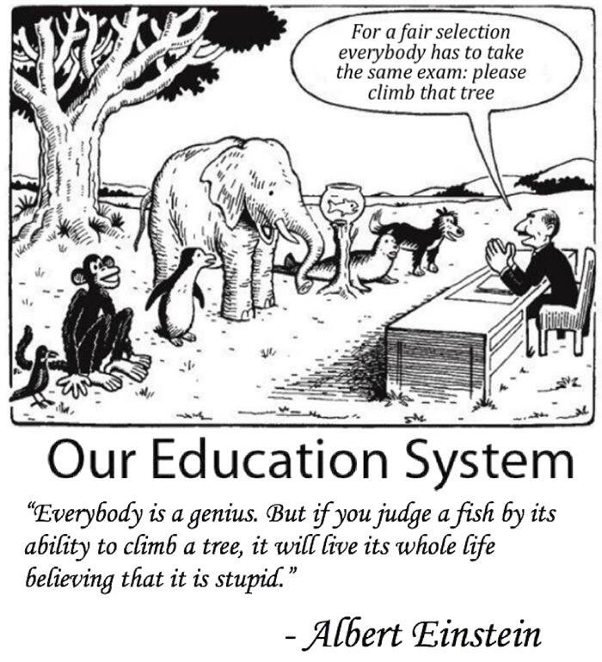
WE
ARE
NOT
THE
SAME

Slide 4
Teacher responsibilities
Class and subject teachers, supported by the senior leadership team, should make regular assessments of progress for all pupils. These should seek to identify pupils making above and below expected progress given their age and individual circumstances.

Slide 5
Teacher responses
The first response to such progress should be high quality teaching targeted at their areas of weakness.
What does this look like in practice?

Slide 6

Differentiation
APDR

Slide 7
Definition
Differentiation is defined by the Training and Development Agency for Schools as ‘the process by which differences between learners are accommodated so that all pupils in a group have the best possible chance of learning’.

Slide 8
Discussion Question
What are you already doing to differentiate instruction in your classroom?

Slide 9
Key Principles of a Differentiated Classroom
• The teacher is clear about what matters in subject matter.
• The teacher understands, appreciates, and builds upon pupil differences.
• Assessment and instruction are inseparable.
• The teacher adjusts content, process, and product in response to pupil readiness, interests, and learning profile.
• Pupils and teachers are collaborators in learning.
• Goals of a differentiated classroom are maximum growth and individual success.
• Flexibility is the hallmark of a differentiated classroom

Slide 10
Differentiated Classroom
• Assessment drives instruction.
• Assessment occurs consistently as the unit begins, throughout the unit and as the unit ends.
• Teachers assess pupil readiness, interest and learning needs

Slide 11

How well do you know your class?
Notes:
Step 1: Name Your pupils.
Take a blank piece of paper or start a simple computer document, and number the left-hand margin with the number of pupils you have in your class. (If you have 25 pupils, number the paper 1-25. If you have more than one class, just choose one group of pupils for this activity.) Then, write down your pupils in the order in which you think of them. Try not to go in alphabetical order or write down all of one gender and then another. Just write them down in the order they appear in your mind.
Just this part of the activity can be interesting. Who comes to mind first, and why? Likely they are the ones who command your attention, either because of their strengths or challenges. Who do you struggle to remember? Why do you struggle to remember them? Are they quiet, compliant, or withdrawn?
Once you have all pupils listed, move to the next step
Step 2: What Do You Know about Your pupils?
Step 3: Do Your pupils Know that You Know Them?
Now What?
Don’t feel badly if you had some blank spaces on your paper. Even though I thought I knew my class really well, when I first tried this activity I was surprised at how much I struggled with a few pupils. This activity isn’t supposed to be a “Gotcha!”—where you feel awful for not yet knowing all of your pupils. Instead, it should be formative. It gives you valuable information. Once you know that you haven’t connected enough with several pupils, it’s time to get to work. Here are a few ideas for making those connections.
Casual chit-chat: When pupils enter the room, when they’re in the hallway, or when they’re in-between activities, strike up a quick conversation. “Jenny, what are you up to this weekend?” “Mark, you’re into sports, right? Are you playing anything right now?”
Morning meeting or advisory: If you run morning meetings or advisory groups, use this as a chance to get to know pupils. Have them share about their hobbies and interests. Later on, follow up with a conversation so you can learn more.
Take notes: Especially if you have multiple classes of pupils, keep track of what you learn about pupils. Keep a simple list of information, organized by pupils’ names. Even if you don’t go back and look at the notes, the act of writing them down will help you remember them.
Games/Activities: As a part of academic work, play some games and activities that help pupils share about themselves. For example, in the game Would You Rather, pupils respond to the prompt, Would you rather read fiction, or would you rather read non-fiction?
Name
What do you know about me?
siblings
pets
food
colour
hobbies
Film/tv/game
ambition
Use Differentiation Planning

Slide 12
Assess

Slide 13

We Need To Ask Ourselves…
Do all pupils have access to the to the tools, knowledge and guidance that they need to succeed?
If not, what can we do to give them those tools?
Notes:
Give details of teaching EXPLICIT SKILLS sheet

Slide 14
EAL or SEN?
Identifying and assessing SEN for children or young people whose first language is not English requires particular care.
Difficulties related solely to limitations in English as an additional language are not SEN.
Notes:
Schools should look carefully at all aspects of a child or young person’s performance in different areas of learning and development or subjects to establish whether lack of progress is due to limitations in their command of English or if it arises from SEN or a disability.

Slide 15
Cognitive Processing Speed Cognition and Learning
• The ability to perform automatically with little or no effort–improves dramatically as children get older.
• Automaticity is linked to speed and processing capacity; as an activity is completed faster, it requires less processing capacity.
• As processing capacity increases, it becomes easier to complete tasks that were previously considered to be difficult. (Santrock & Yussen, 1992).

Slide 16
Executive Functions and Working Memory
• Many executive function tasks also require working memory—actively holding information in memory during cognitive tasks.
• Children with poor working memory may lose the “thread” and forget parts of the instruction, or even their own intention in the face of competing stimuli.

Slide 17
Children who have significant working memory difficulties often have the following profile:
Normal social relationships with peers
Reserved in group activities
Poor academic progress in reading and maths
Difficulties in following instructions
Struggle to cope with learning activities that require both storage and processing demands
Place-keeping difficulties
Appears to have short attention span/ daydreaming/ lacking motivation/ distractible, behavioural difficulties.
Difficulty copying from the board
Notes:
As a child gets older, demands placed on their working memory increase, and this can cause overload. How can we recognise poor working memory in the classroom?

Slide 18
Interleaving ‘v’ Blocking
Blocking = the solution to use, movement to execute, rote learning, copying
Interleaving = each practice attempt is different from the last; the brain must continuously focus on searching for different solutions. That process can improve your ability to learn critical features of skills and concepts, which then better enables you to select and execute the correct response.
Interleaving strengthens memory associations. With blocking, a single strategy, temporarily held in short-term memory, is sufficient.
Children with poor working memory struggle with interleaving ; every task is new and they fail to make connections therefore ‘blocking’ and repeating a process can reinforce neural connections between different tasks and correct responses, which enhance learning.

Slide 19
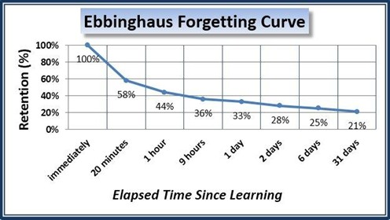
Maintaining, reinforcing and consolidating
Notes:
Ebbinghaus’ Forgetting Curve is a stark reminder of how quickly we forget information that we don’t need to access regularly.

Slide 20



READINESS | INTEREST | LEARNING NEEDS
Content knowledge Skills Concepts | • Interest Surveys • Interest Centres • Self-Selection | • Areas of Strength and Weakness • Work Preferences • Self Awareness

Slide 21

Pre-assessment Is...
Any method, strategy or process used to determine a pupil’s current level of readiness or interest in order to plan for appropriate instruction.
• provides data to determine options for pupils
• helps determine differences before planning
• helps teacher design activities that are meaningful and challenging
• allows teachers to meet pupils where they are
• identifies starting point for instruction
• identifies learning gaps
• makes efficient use of instructional time
Notes:
Quickly look at Rome pre-assessment sheet and Pupil as a learner sheet
Will a need for slides abour information processing speed, working memory,

Slide 22
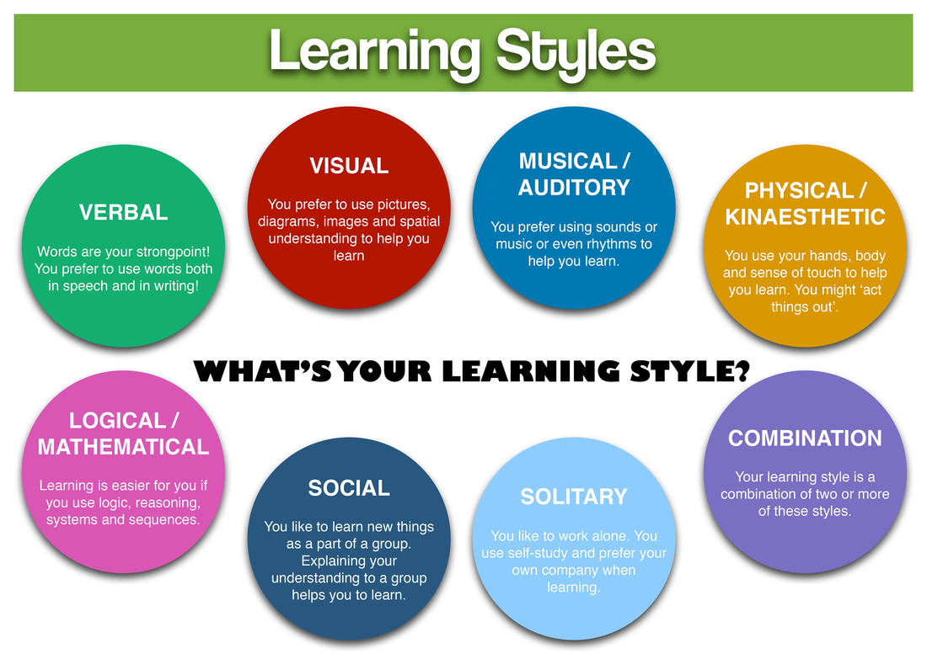
Consider….

Slide 23
Formative Assessment is…
A process of accumulating information about a pupil’s progress to help make instructional decisions that will improve his/her understandings and achievement levels.
• Depicts pupil’s life as a learner
• used to make instructional adjustments
• alerts the teacher about pupil misconceptions “ early warning signal”
• allows pupils to build on previous experiences
• provides regular feedback
• provides evidence of progress
• aligns with instructional/curricular outcomes

Slide 24
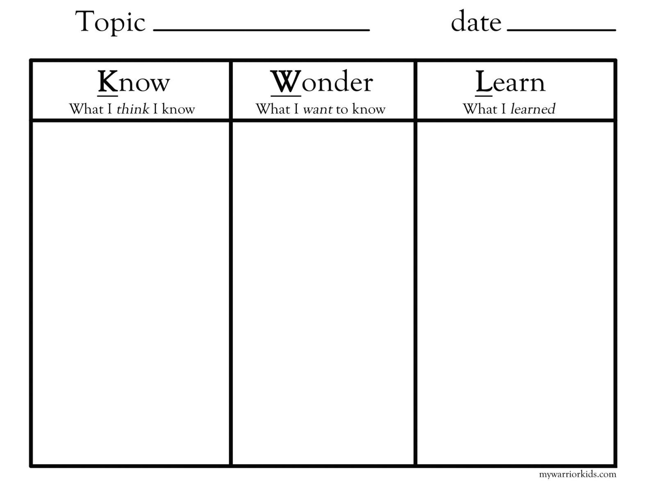
KWL Grids

Slide 25
Some examples of pre-assessment and formative assessment techniques
Teacher prepared pre-tests
KWL charts and other graphic organisers
Writing prompts/samples
Questioning
Guess Box
Picture Interpretation
Prediction
Teacher observation/checklists pupil demonstrations and discussions
Initiating activities
Informational surveys/Questionnaires/Inventories pupil interviews pupil products and work samples
Self-evaluations
Portfolio analysis (EYFS)
Game activities
Show of hands to determine understanding
Drawing related to topic or content
Standardised test information

Slide 26
HOW?
Planning & Doing

Slide 27
High quality teaching
High quality teaching, differentiated for individual pupils:
Task
Grouping
Pace
Resources
Support
Outcome
Notes:
Task
One of the core methods of differentiation, differentiation by task, involves setting different tasks for pupils of different abilities. One way to achieve this may be to produce different sets of worksheets or exercises depending on pupils’ abilities. However, some teachers are loath to employ this method because of both the social implications and the additional planning it entails. An alternative method is to use a single worksheet comprised of tasks which get progressively harder. The more advanced pupils will quickly progress to the later questions whilst the less able can concentrate on grasping the essentials.
Grouping
Collaborative learning has many well-documented benefits such as enabling shy pupils to participate more confidently in class, but it’s also a useful differentiation method. Small, mixed-ability groups allow lower achievers to take advantage of peer support whilst higher achievers gain the opportunity to organise and voice their thoughts for the benefit of the whole group (known as peer modelling). Grouping also allows roles to be allocated within the team which cater for each member’s skill set and learning needs.
Resources
Differentiation in the classroom - ipads in classroomIn this method it’s important to recognise that some pupils can work with more advanced resources than others, and that it is possible to use multiple materials in order to approach a topic from different angles. This means that while some may require quite basic texts with illustrations, others are capable of working with more advanced vocabulary and complex ideas. Differentiation of this kind allows a wide spectrum of materials to be used to attain a single learning outcome. It’s a method that is greatly assisted by advances in technology, and the use of educational video in the classroom, which is why it is becoming more prevalent.
Pace
In the traditional classroom, activities are completed within a single time frame, irrespective of the level of difficulty for some pupils. The result is that more advanced learners can be held back to the speed of the less able ones, and at the other end of the scale, some may simply find it impossible to keep up. When differentiation is used in lesson planning, the available time is used flexibly in order to meet all pupils’ needs. pupils who quickly grasp core activities need not be held back because their classmates need to spend more time on the fundamentals of a topic. They can instead be allocated more challenging extension tasks in order to develop a more rounded understanding of the subject matter or even to progress through the set course more quickly.
Outcome
Differentiation by outcome is a technique whereby all pupils undertake the same task but a variety of results is expected and acceptable. For example, the teacher sets a task but instead of working towards a single ‘right’ answer, the pupils arrive at a personalised outcome depending on their level of ability. It’s a method about which some teachers have reservations as there is a risk that the less able pupils will fall below an acceptable level of understanding, however that risk can be mitigated somewhat by establishing a clear set of guidelines that apply to all pupils, and it does offer one clear advantage in that no prior grouping is necessary.
Dialogue and support
Differentiation by dialogue is the most regularly used type of differentiation in the classroom. With this technique, the emphasis is on the role of the teacher, who must facilitate problem solving by identifying which pupils need detailed explanations in simple language and which pupils can engage in dialogue at a more sophisticated level. The teacher may also employ targeted questioning to produce a range of responses and to challenge the more able pupils. Verbal support and encouragement also plays a crucial part in this technique.
Assessment
In the differentiated classroom, rather than assessment taking place at the end of learning, pupils are assessed on an on-going basis so that teaching, and indeed the other methods of differentiation, can be continuously adjusted according to the learners’ needs.
Differentiation in the classroom is all about understanding that we are dealing with a group of diverse individuals and adapting our teaching to ensure that all of them have access to learn. It should be an on-going and flexible process which not only profiles pupils initially but also recognises progress and areas for improvement and adjusts accordingly to ensure learning needs continue to be met. In short, it shifts the focus from teaching a subject to teaching the pupils.

Slide 28
What is task differentiation? What might some of the difficulties be? Ideas to make it more manageable?
Notes:
What is task differentiation?
One of the core methods of differentiation, differentiation by task, involves setting different tasks for pupils of different abilities. One way to achieve this may be to produce different sets of worksheets or exercises depending on pupils’ abilities.
What are the difficulties?
However this can entail a LOT of additional planning.
Can also be detrimental in terms of self-esteem and confidence.
Ways to make it more manageable
An alternative method is to use a single worksheet comprised of tasks which get progressively harder. The more advanced pupils will quickly progress to the later questions whilst the less able can concentrate on grasping the essentials.
Take a practical and realistic approach to task differentiation. When planning group work, try to plan so that groups can access work at different times in the week, so that the less able cover the work set at the middle group level by Wednesday for example - this saves planning four different types of work for each group, each day.

Slide 29

RAFT
RAFT is an acronym that stands for Role of the pupil. What is the pupil’s role: reporter, observer, eyewitness, object? Audience. Who will be addressed by this raft: the teacher, other pupils, a parent, people in the community, an editor, another object? Format. What is the best way to present this information: in a letter, an article, a report, a poem, a monologue, a picture, a song? Topic. Who or what is the subject of this writing: a famous mathematician, a prehistoric cave dweller, a reaction to a specific event?
Notes:
Look at RAFT notes

Slide 30
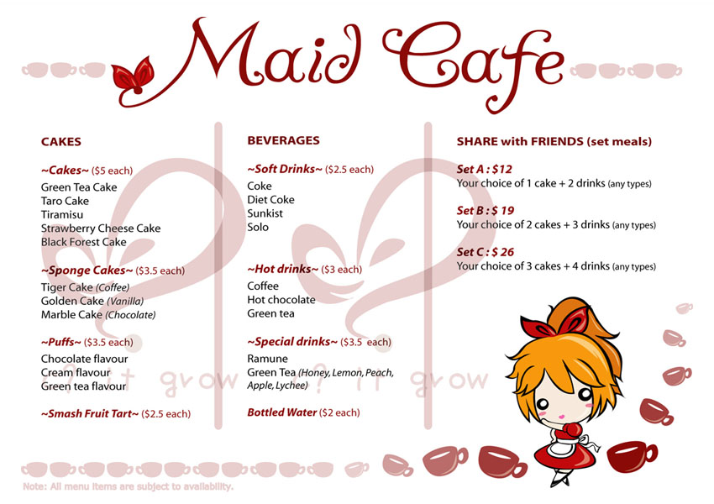
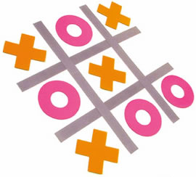

Concept Menu
Think-Tac-Toe
Learning Contract
Notes:
Look at examples of Concept menu, tic tac toe and learning contract

Slide 31
Get Creative with Tasks
Map Diagram Sculpture Discussion Demonstration Poem Profile Chart Play Dance Campaign Recording Quiz Show Banner Brochure Debate Flow Chart Puppet Show Tour
Presentation Editorial Painting Costume Placement Blueprint Catalogue Dialogue Newspaper Scrapbook Questionnaire Flag Scrapbook Graph Museum Learning Centre Advertisement Book List Calendar Colouring Book Game Research Project TV Show Song Dictionary Film Collection Trial Machine Book Mural Award Recipe Test Puzzle Model Timeline Toy Article Diary Poster Magazine Computer Program Photographs Petition Teaching Lesson Prototype Speech Club Cartoon Biography Review Invention

Slide 32



Flexible Grouping
Pupils are part of many different groups (and also work alone) based on the match of the task to pupil readiness, interest, or learning needs.
Teachers may create skills based or interest based groups that are heterogeneous or homogeneous in readiness level.
Sometimes pupils select work groups, and sometimes teachers select them. Sometimes pupil group assignments are purposeful and sometimes random.

Slide 33
Grouping
Small, mixed-ability groups allow lower achievers to take advantage of peer support whilst higher achievers gain the opportunity to organise and voice their thoughts for the benefit of the whole group
( peer modelling).
Grouping also allows roles to be allocated within the team which cater for each member’s skill set and learning needs.
Notes:
Peer support through collaborative learning has many well-documented benefits such as enabling shy pupils to participate more confidently in class, but it’s also a useful differentiation method.

Slide 34
Pace
How is this achieved?
Notes:
In the traditional classroom, activities are completed within a single time frame, irrespective of the level of difficulty for some pupils. The result is that more advanced learners can be held back to the speed of the less able ones, and at the other end of the scale, some may simply find it impossible to keep up. When differentiation is used in lesson planning, the available time is used flexibly in order to meet all pupils’ needs. Pupils who quickly grasp core activities need not be held back because their classmates need to spend more time on the fundamentals of a topic. They can instead be allocated more challenging extension tasks in order to develop a more rounded understanding of the subject matter or even to progress through the set course more quickly.

Slide 35
Resources
In this method it’s important to recognise that some pupils can work with more advanced resources than others, and that it is possible to use multiple materials in order to approach a topic from different angles.
What resources do you have in your
class to help different learners?
Notes:
This means that while some may require quite basic texts with illustrations, others are capable of working with more advanced vocabulary and complex ideas. Differentiation of this kind allows a wide spectrum of materials to be used to attain a single learning outcome. It’s a method that is greatly assisted by advances in technology and the use of educational video clips which is why it is becoming more prevalent.

Slide 36
Different types of resources
Visual support
Physical support
Auditory support
Scaffolding
Verbal
Technology
Notes:
Think of group work using a traffic light system: green for work they can do unaided once explained; amber for work that may require support; and red for work that requires a teacher or TA to 'scaffold' it. Then you can plan around the support staff that you have."
Visual support– visual timetables, alphabet arcs, word mats, table/number squares, tricky words, new word lists, SCUBA cards (see Spring term 2013 senco network)
o Physical support – mini- white boards, number fans, arrow cards, counters, cubes, shapes. Support with spelling, cribing or supporting using alternatives ways to write/record, signing, ICT support, adaptive resources, practical experiences, games.
o Scaffold learning – mind maps, spider grams, writing frames, talking frames, role play, substitution tables.
o Verbal – develop talk for learning, rehearsing what to write verbally first, encourage peer discussion, support with reading. Model good quality talk

Slide 37
Support
Teacher
TA using WDEP method
Peers
Buddy system
Parental

Slide 38


Teaching Assistants should not be used as an informal teaching resource for low-attaining pupils.
Notes:
The DISS project (Deployment and Impact of Support Staff) research by the Education Endowment Foundation between 2003-8
Found there has been a drift towards TAs taking on role of ‘primary educator’ for low attaining/SEN pupils.
Well meaning but flawed.
Associated with significantly lower learning outcomes.
Ensure that pupils with SEND receive as much time with teacher as other pupils

Slide 39
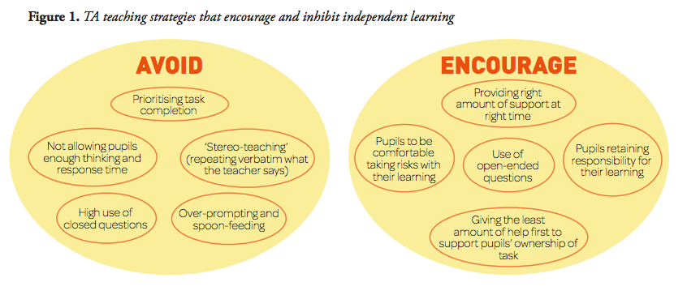
Effective Use of TAs
Notes:
TA support works best and enhances outcomes when:
•TAs support learning activities rather than manage tasks
•TAs focus on the learning and not on completion of task
•Teachers do not reduce their support to the pupil
•Teachers and TAs have conversations about the learning.

Slide 40
Outcome
What is it?
Are there any drawbacks?
Notes:
Differentiation by outcome is a technique whereby all pupils undertake the same task but a variety of results is expected and acceptable. For example, the teacher sets a task but instead of working towards a single ‘right’ answer, the pupils arrive at a personalised outcome depending on their level of ability.
It’s a method about which some teachers have reservations as there is a risk that the less able pupils will fall below an acceptable level of understanding, however that risk can be mitigated somewhat by establishing a clear set of guidelines that apply to all pupils, and it does offer one clear advantage in that no prior grouping is necessary.

Slide 41
Review

Slide 42
Summative Assessment Is...
A means to determine a pupil’s mastery and understanding of information, skills, concepts, or processes.
• Should reflect formative assessments that precede it
• should match material taught
• may determine pupil’s exit achievement
• may be tied to a final decision, level or report
• should align with instructional/curricular outcomes
• may be a form of alternative standardised assessment

Slide 43




Squaring Off
Yes or No cards
Thumbs and Fingers
Cubing
Notes:
Look at squaring off, y/n cards, thumbs and fingers and cubing

Slide 44
Reflection and readiness – Assess
Use these questions to assess your school’s readiness for this
aspect of the graduated approach:
• How are we ensuring that we are identifying pupils’ needs as early as possible?
• Can we improve our liaison with pre-school/feeder schools to prepare for pupils with SEN as soon as they arrive?
• Do we have systems, tools and expertise to support identification and assessment?
• Do class/subject teachers make effective use of these tools to identify pupils’ gaps in and barriers to learning, adapting their core teaching in the light of these findings?
• Do we call on the support of a range of external specialists as and when we need it?
• Are there any areas where our staff need training to support identification?

Slide 45
Useful resources
What works for children with literacy difficulties
What works for children with mathematical difficulties
The effective management of teaching assistants to improve standards in literacy and mathematics
www.visualaidsforlearning.com
http://mrcrammond.com/writing_frames.htm
www.eal.britishcouncil.org
Notes:
The effective management of teaching assistants to improve standards in literacy and mathematics. DfES 1228-2005 G
http://teachfind.com/search/apachesolr_search/The%20effective%20management%20of%20teaching%20assistants
Effective leadership: ensuring the progress of pupils with SEN and/ or disabilities
http://teachfind.com/national-strategies/effective-leadership-ensuring-progress-pupils-sen-–-deployment-teaching-assistan?current_search=Effective%20leadership%3A%20ensuring%20the%20progress
What works for children with literacy difficulties
http://www.interventionsforliteracy.org.uk/widgets_GregBrooks/What_works_for_children_fourth_ed.pdf
What works for children with mathematical difficulties
http://www.nationalnumeracy.org.uk/resources/22/index.html%20

Slide 46
Differentiation in the classroom is all about understanding that we are dealing with a group of diverse individuals and adapting our teaching to ensure that all of them have access to learn. It should be an on-going and flexible process which not only profiles pupils initially but also recognises progress and areas for improvement and adjusts accordingly to ensure learning needs continue to be met
In short, it shifts the focus from teaching a subject to teaching the pupils.

